Slide 1
Day 2: Advanced Topics in GIS

Slide 2
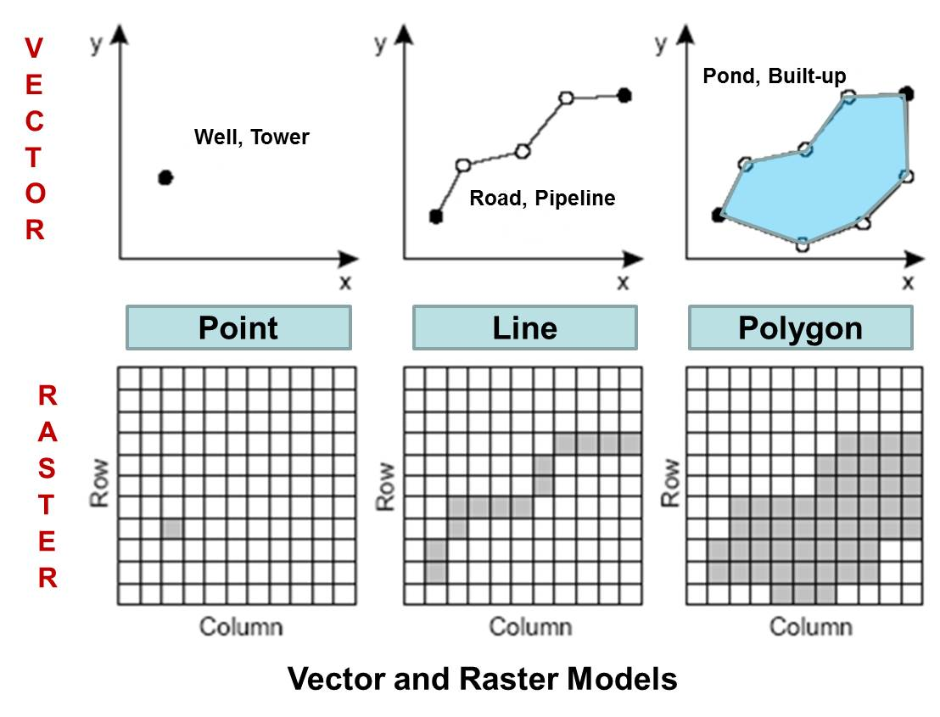
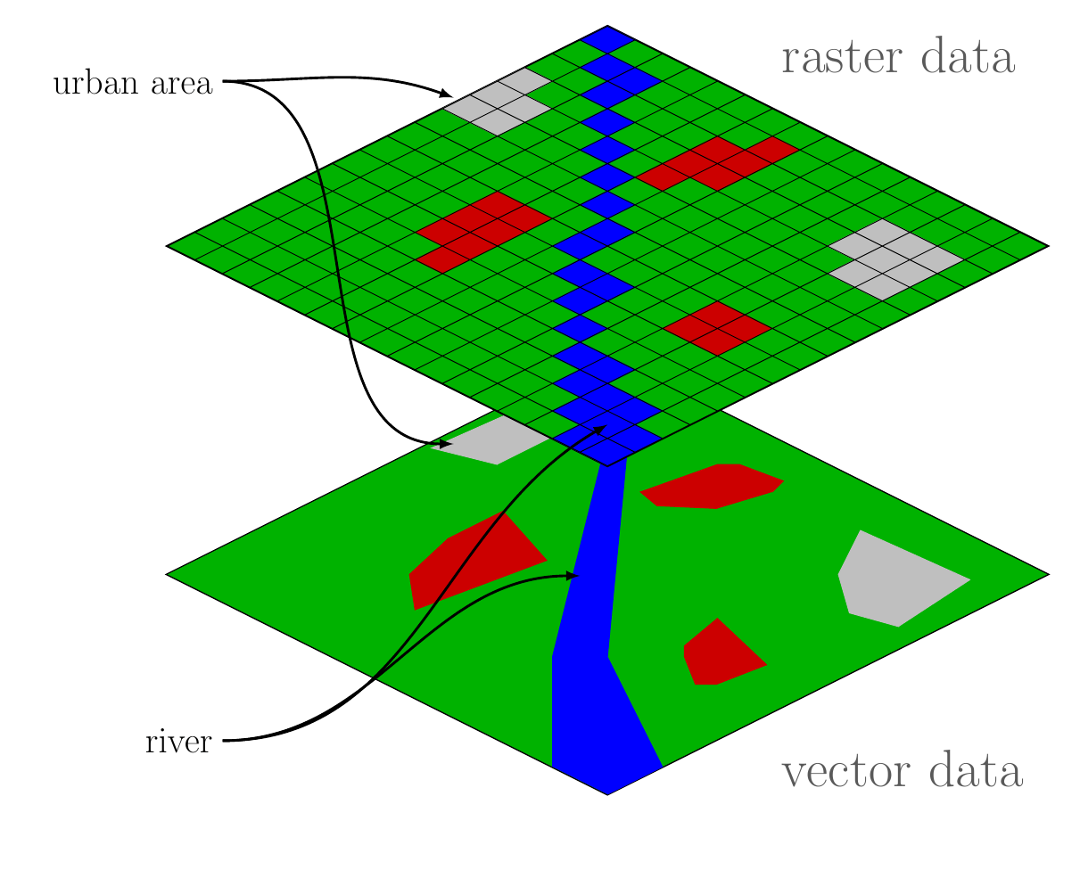
Recap of what’s covered on Day 1

Slide 3
Today’s Agenda
Reprojection (revisited)
Zonal statistics
Data quality issues
Data cleaning
Geometric operations with vector data
Geometric operations with raster data

Slide 4
Reprojection revisited
It’s important to know the Coordinate Reference System (CRS) of spatial data whether it’s vector or raster data!
CRS provide a standardized way of describing locations, chosen depending on when the data was collected, the geographic extent of the data, the purpose of the data, etc.
WGS84 (EPSG:4326) is commonly used by organizations that provide GIS data for the entire globe or many countries (CRS used by Google Earth)
But some datasets do not use WGS84, like data from Global Human Settlement Layer

Slide 5
Reprojection revisited
Use EPSG codes to standardize projections within a project:
A particular CRS can be referenced by its EPSG code (i.e., epsg:4121).
The EPSG is a catalogue of CRS and Coordinate Transformations.
You can look up an appropriate EPSG code for your own country in https://epsg.io/.
For instance, when computing areas in km^2, you would need to reproject your data to UTM.

Slide 6
Why does differences in CRS matter?
2-lecture_code.R

Slide 7
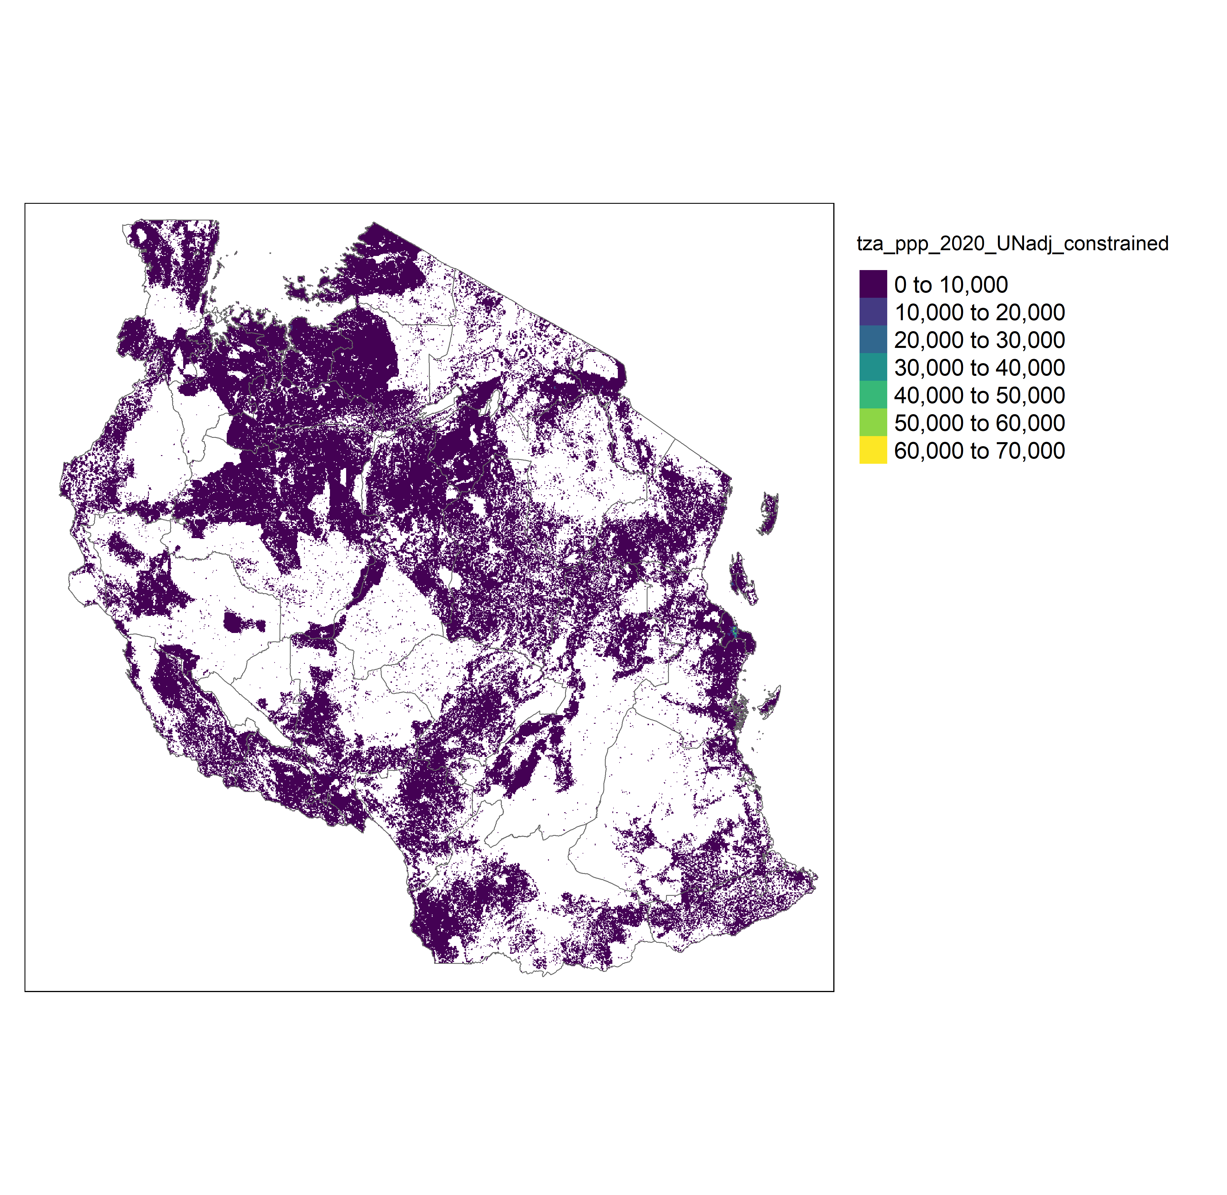
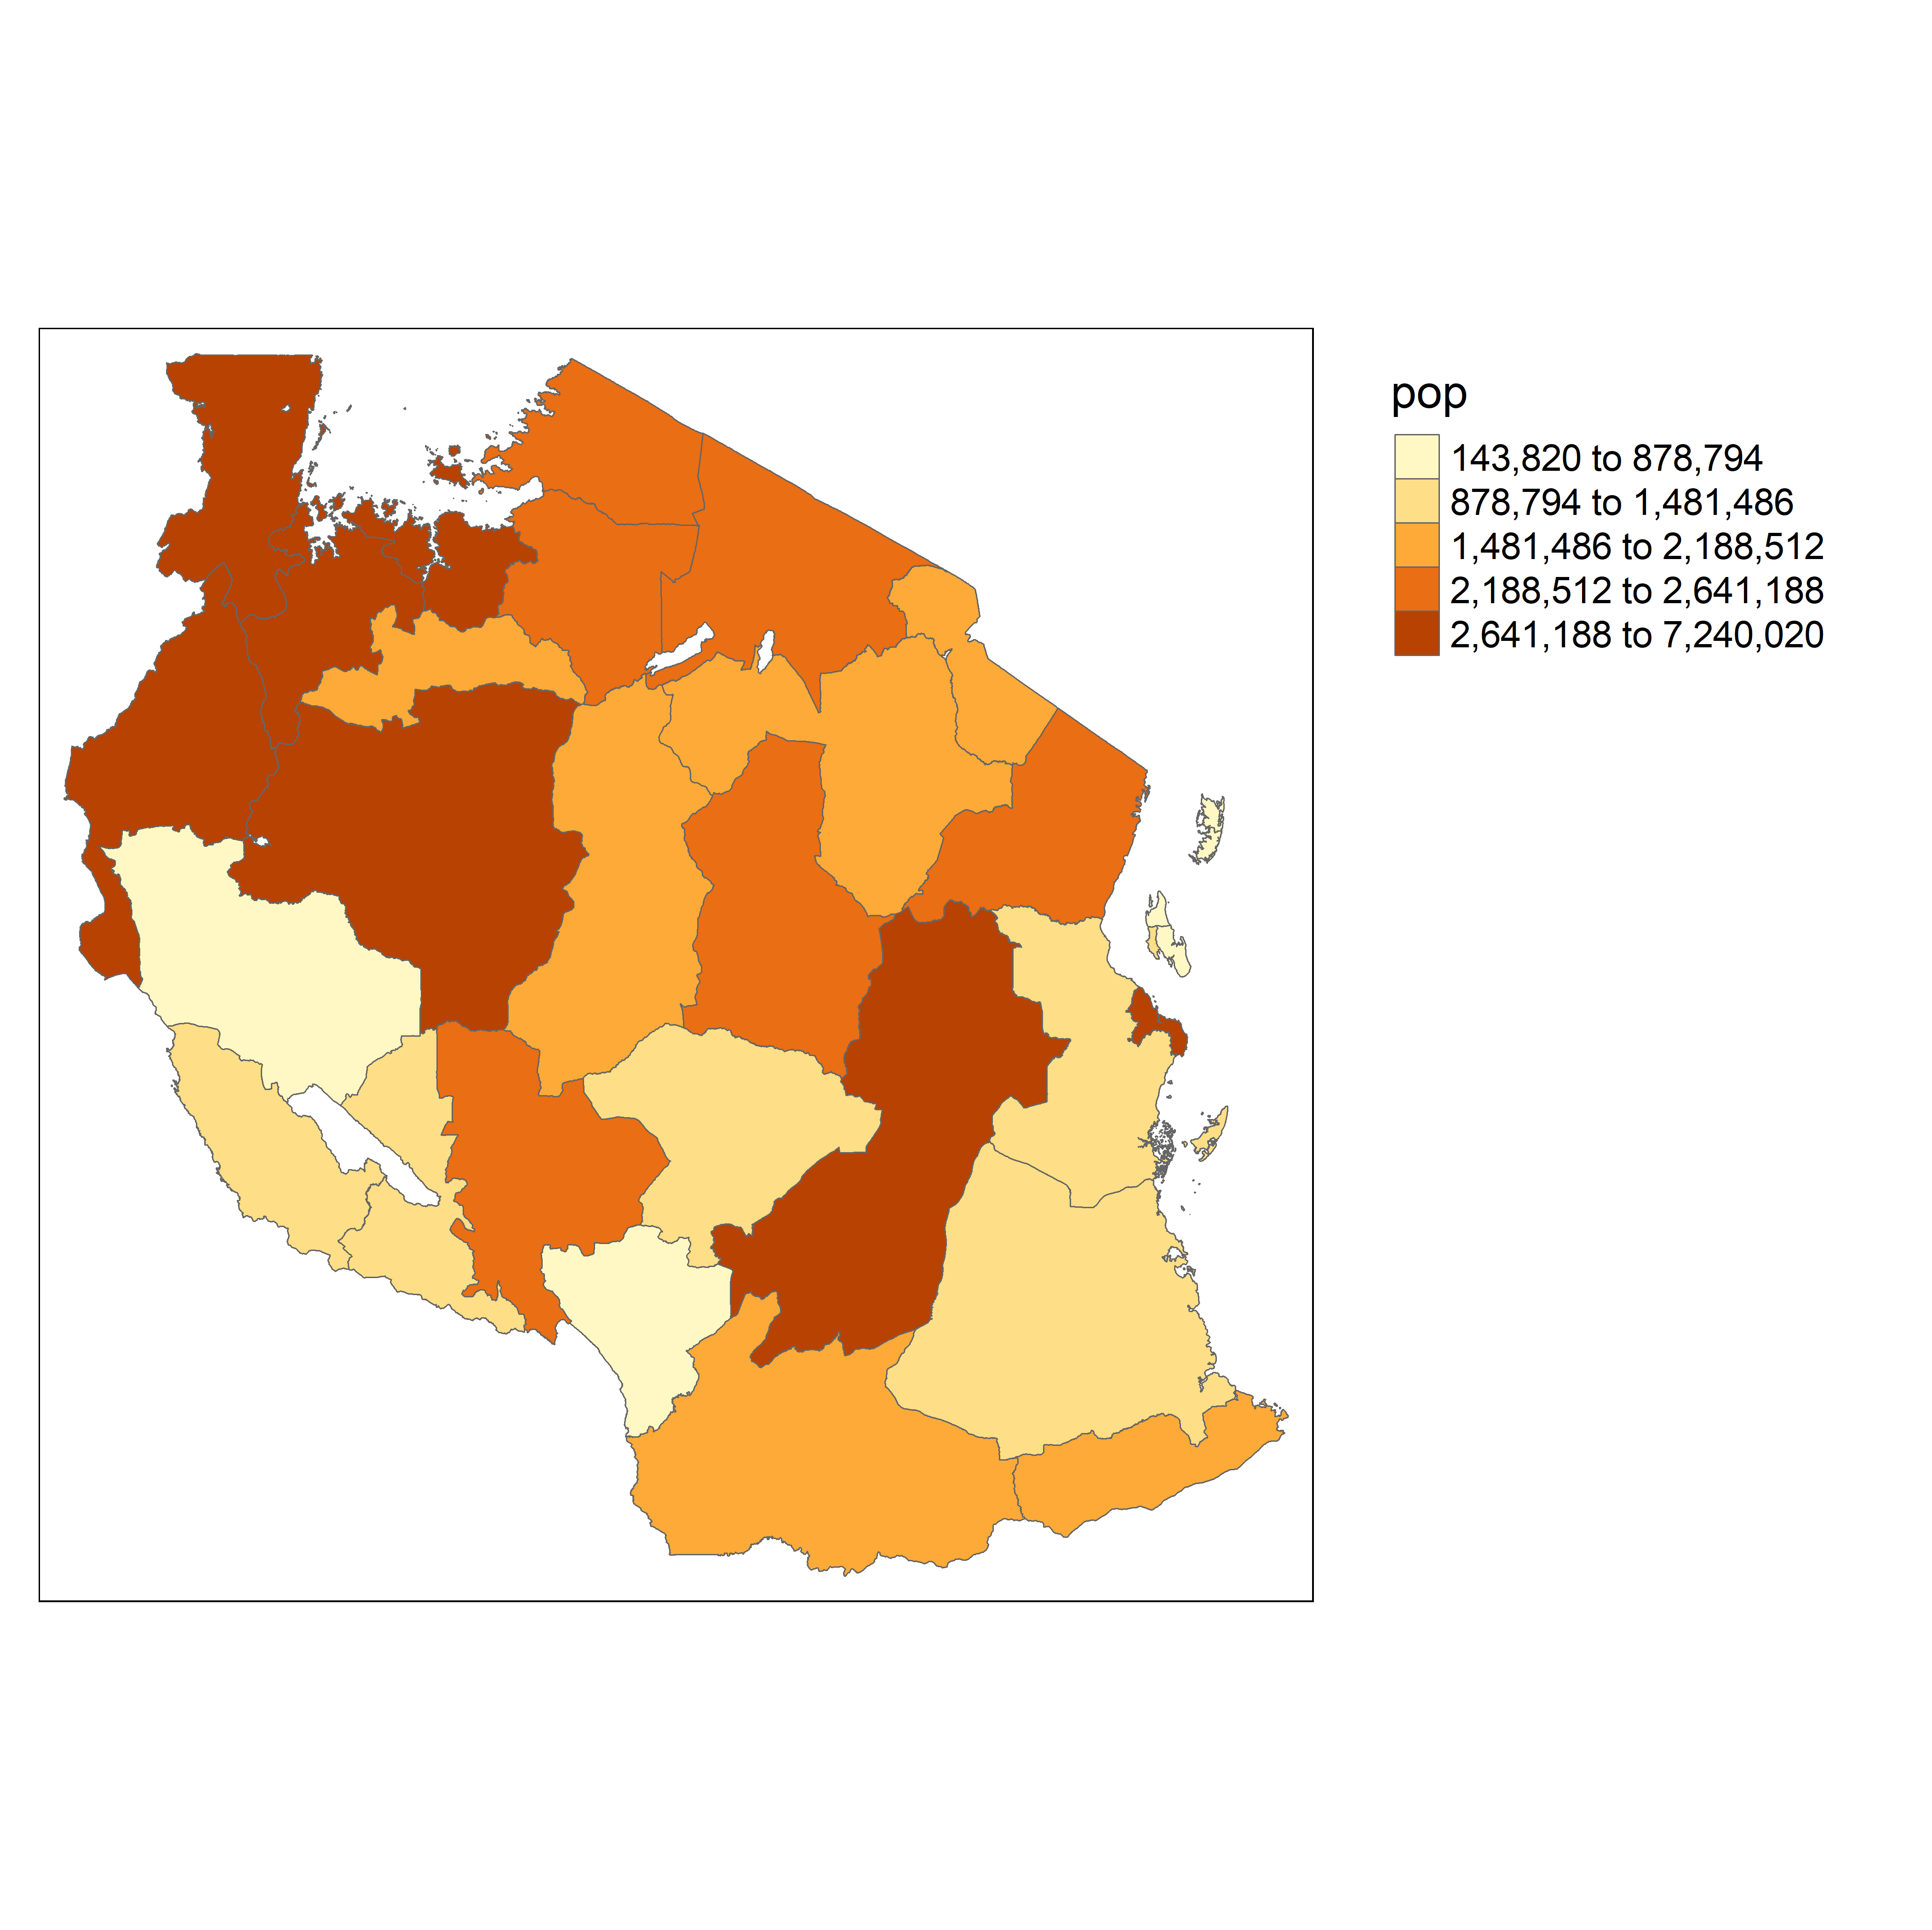
Zonal Statistics
Zonal statistics is a term for raster values that are summarized over polygonal areas.
Example:

Slide 8
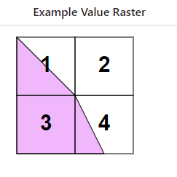
Zonal Statistics: How do we do this in R (link)
exactextractr is an R package that quickly and accurately summarizes raster values over polygonal areas, commonly referred to as zonal statistics.
Unlike most zonal statistics implementations, it handles grid cells that are partially covered by a polygon.
Despite this, it performs faster than other packages for many real-world applications.
If using “sum” in exact_extract()
50%
0%
0.5*1 + 0*2 + 1*3 + 0.25 * 4 = 4.5
If using “sum” in exact_extract()
100%
25%
(0.5*1 + 0*2 + 1*3 + 0.25 * 4) /
(0.5 + 1 + 0.25) = 2.57

Slide 9
Zonal Statistics: How do we do this in R
2-lecture_code.R

Slide 10
Data quality

Slide 11

Data quality
Precision in raster data
Higher resolution + precision
Lower resolution + precision

Slide 12
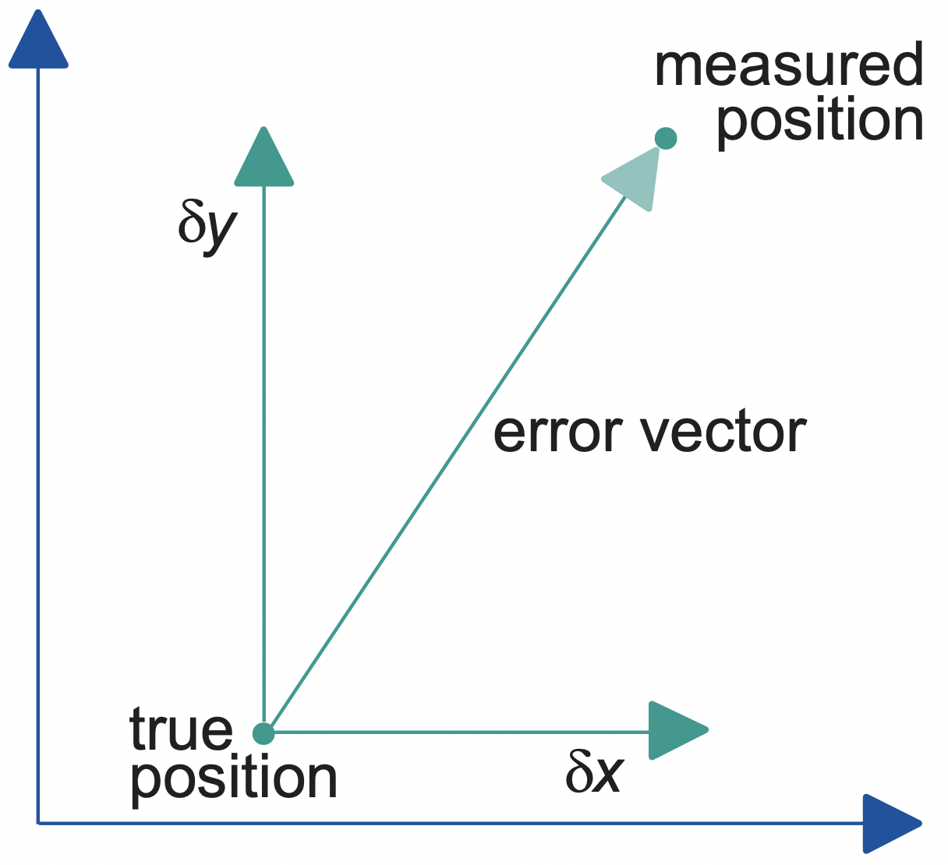
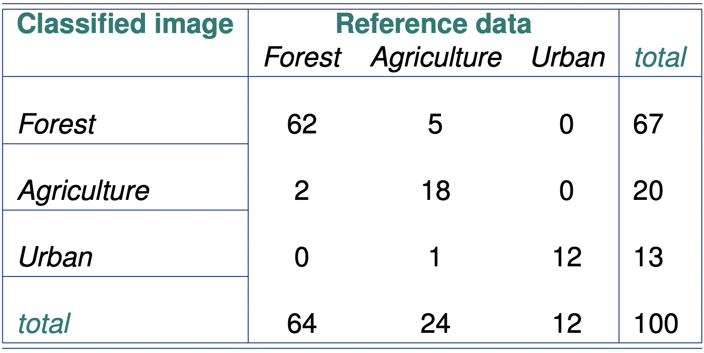
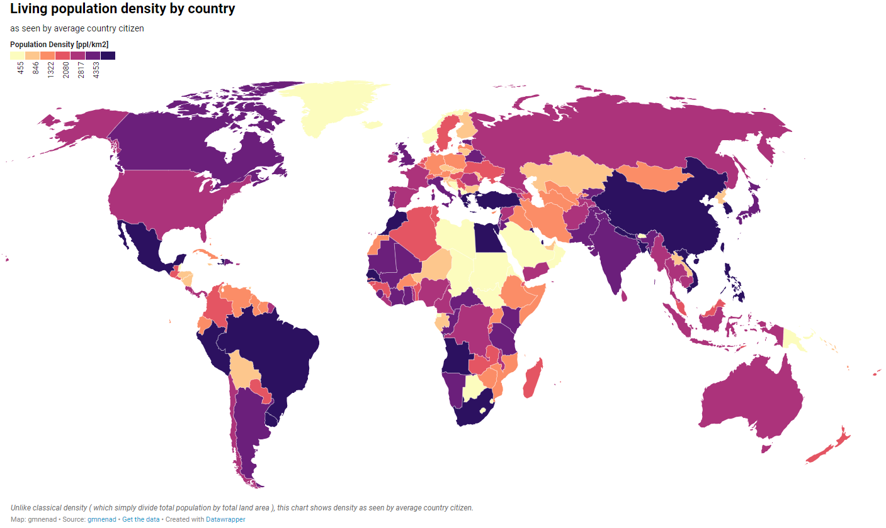



Data quality
Positional accuracy
Example: location of schools
Attribute accuracy
Example: type of land cover
Temporal accuracy
Example: year of population statistics
Year: 2020 Year: 2015
Lineage
Example: metadata of how the population data is collected
Completeness
Example: availability of economic data in all regions
Logical consistency
Example: Consistency among population, area, and population density

Slide 13
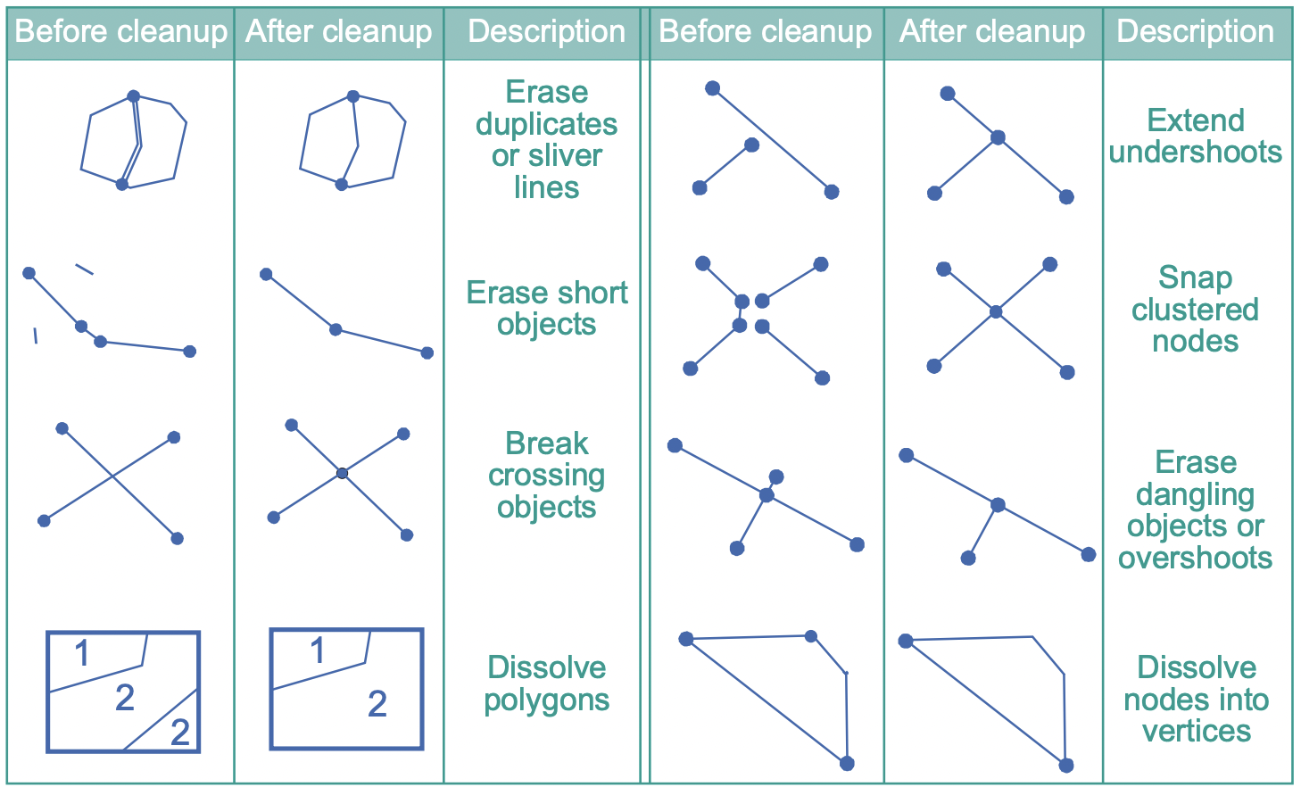
Data quality
Spatial data clean-up procedure

Slide 14
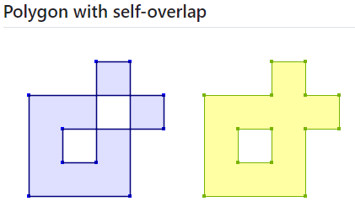
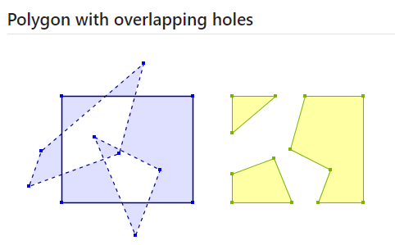
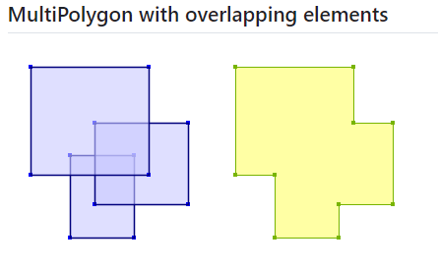
How to fix invalid geometry: st_make_valid()

Slide 15
How to correct geometry issues
2-lecture_code.R

Slide 16
2-handson.R
Hands-on exercise

